Slide 1
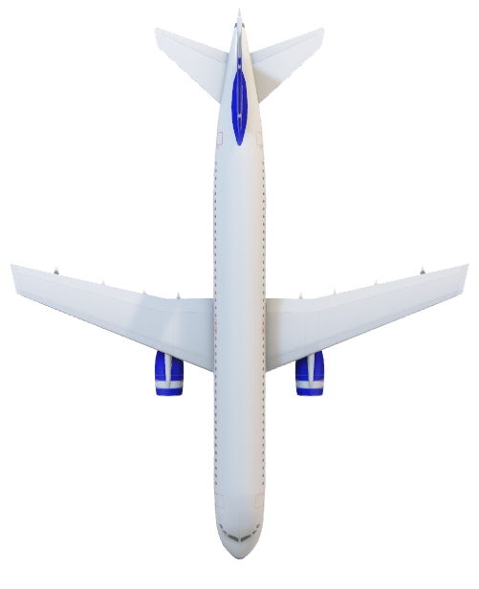
Indian Airlines
PROJECT
Ticket Price Analysis

Slide 2

Indian Airlines Ticket Price
Objective
Aim to answer questions like No. of flights available across India,
Ticket availability across different class,
Price range across different class, etc.

Slide 3
About the dataset The dataset includes details on the ticket booking alternatives available through the website "Easemytrip" for flights between India's top 6 metro areas. The cleaned dataset contains 11 characteristics and 300261 datapoints. Data was gathered in two stages: for business class tickets and for economy class tickets. The site provided a total of 300261 unique flight booking possibilities. 50 days of data were gathered, from February 11 to March 31 of 2022.
The various features of the dataset are explained below:
Airline: The airline column contains the name of the airline firm.
Flight: The flight code of the aircraft is stored in flight.
Source City: City where the flight departs from is a classification feature with 6 distinctive cities.
Departure Time: This is a categorical feature that was deduced from time periods being divided into bins.
Stops: A category feature that holds the number of stops between the source and destination cities.
Arrival Time: This derived categorical feature was developed by binning time intervals. It maintains information regarding the arrival time.
Destination City: The location of the aircraft's landing.
Class: A permanent feature that shows the total number of hours needed to travel between cities.
Duration: A permanent feature that shows the total number of hours needed to travel between cities.
Days Left: The trip date is subtracted from the booking date to arrive at this derived feature.
Price: Information about the ticket price is stored in the target variable.

Slide 4
Ⅰ
Ⅱ
Ⅲ
EDA
Questioning
Insights

Slide 5
Ⅰ
Ⅱ
Ⅲ
Questioning
EDA
Insights

Slide 6
Ⅰ
Ⅱ
Ⅲ
Questioning
EDA
Insights

Slide 7
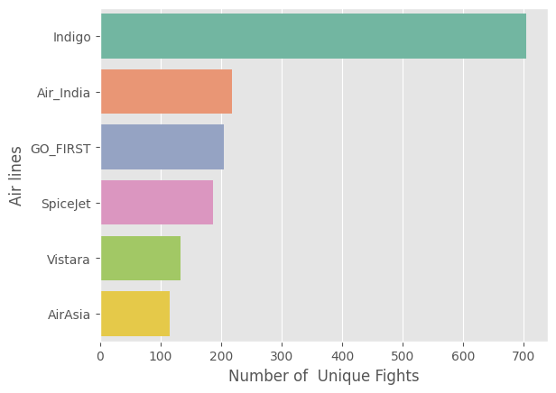
Unique
Number of unique flights operating by airlines.

Slide 8
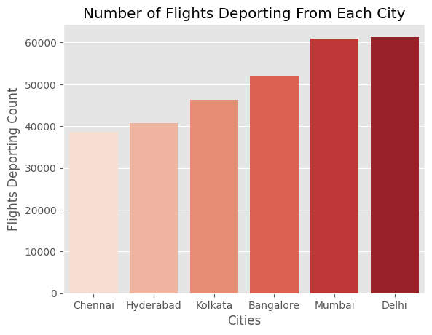
Deporting
The Palette Density in this chart describes the value count of each category. Least flights are deporting from Chennai and Delhi is highest in deporting flights 🛫🛫🛫

Slide 9
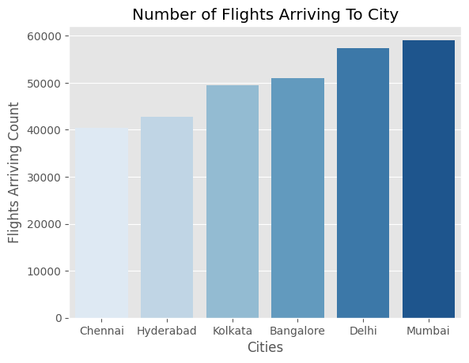
Arriving
👆👆👆 This explains the Flight arrivals from other cities. Chennai receiving the less flights and Mumbai receiving highest number of flights from other cities🛬🛬🛬

Slide 10
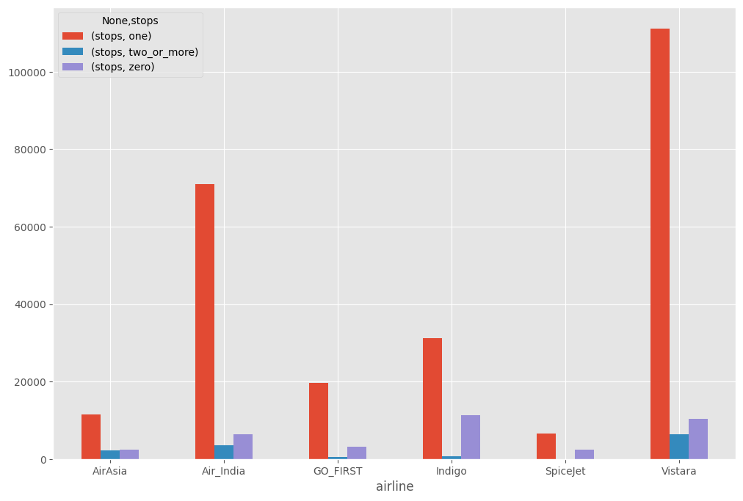
Stops / Via
Number of stops, flights of different airlines are taking throughout the journey

Slide 11
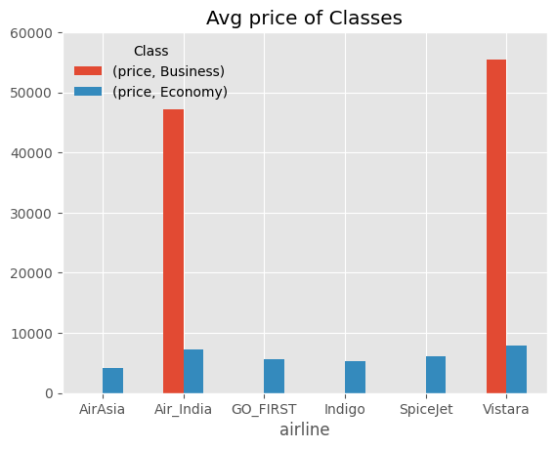
Price vs Class
A look through of an Airlines Ticket price according to the class

Slide 12
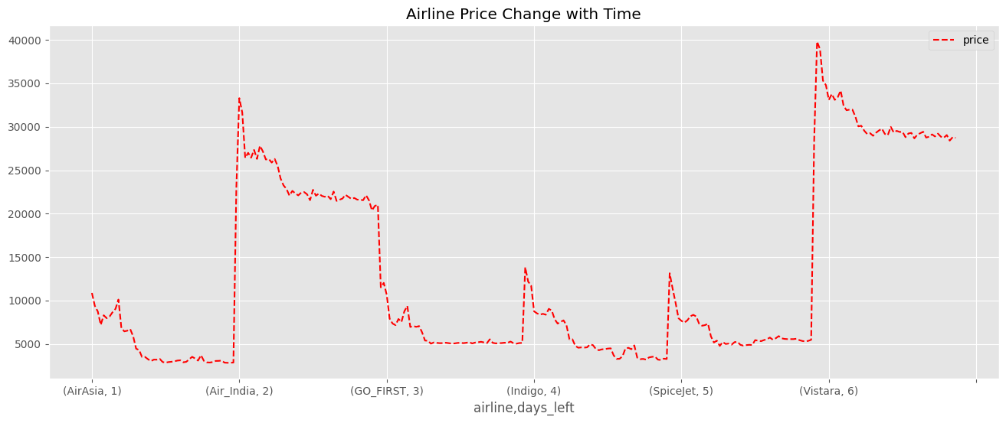
Average Price of Ticket vs Time

Slide 13
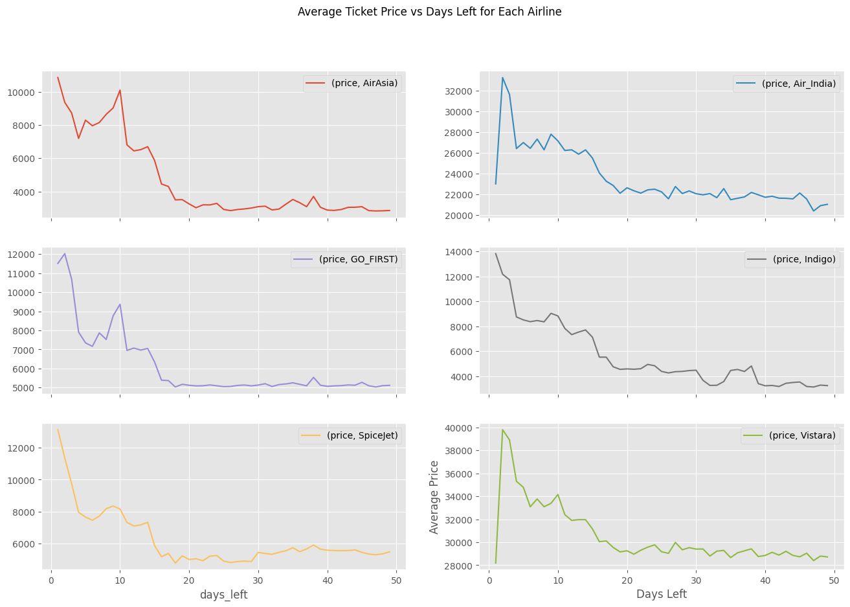
Sub Plots of airlines (Average Price vs Days Left)

Slide 14
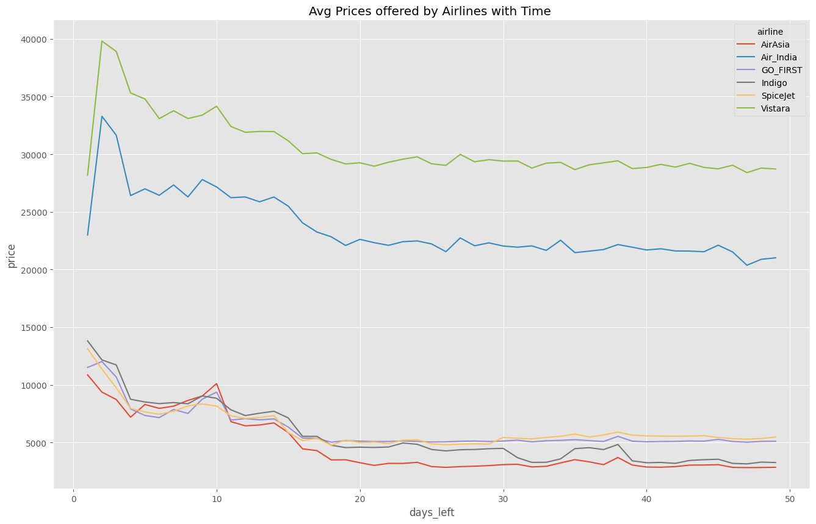
Average Price vs Days Left

Slide 15
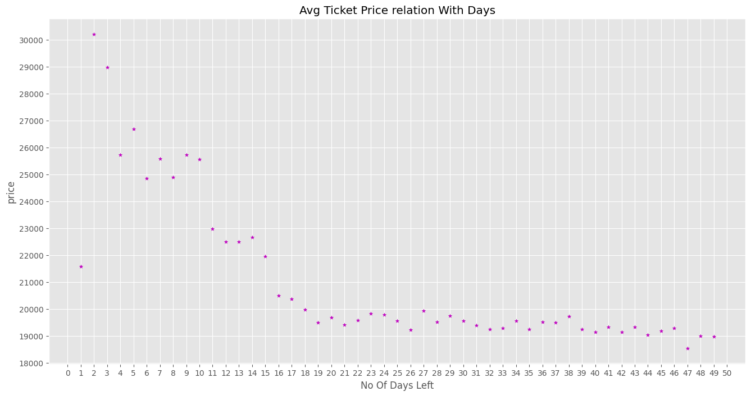
Mean Price of Tickets before purchase date

Slide 16
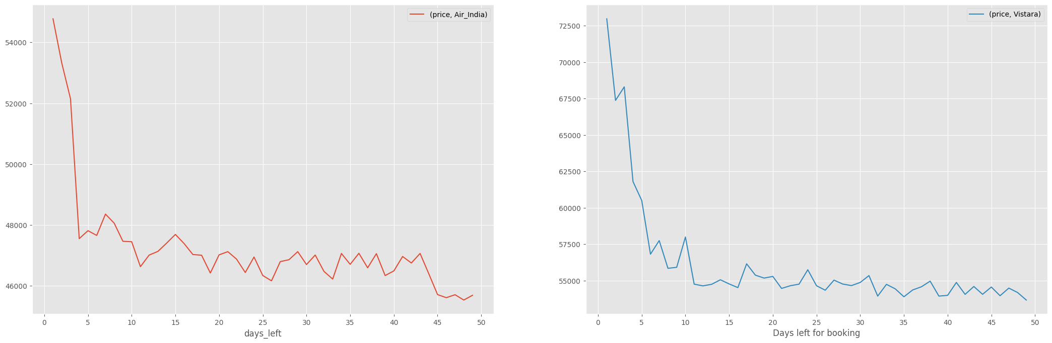
Business Class Pricing vs Days Left

Slide 17
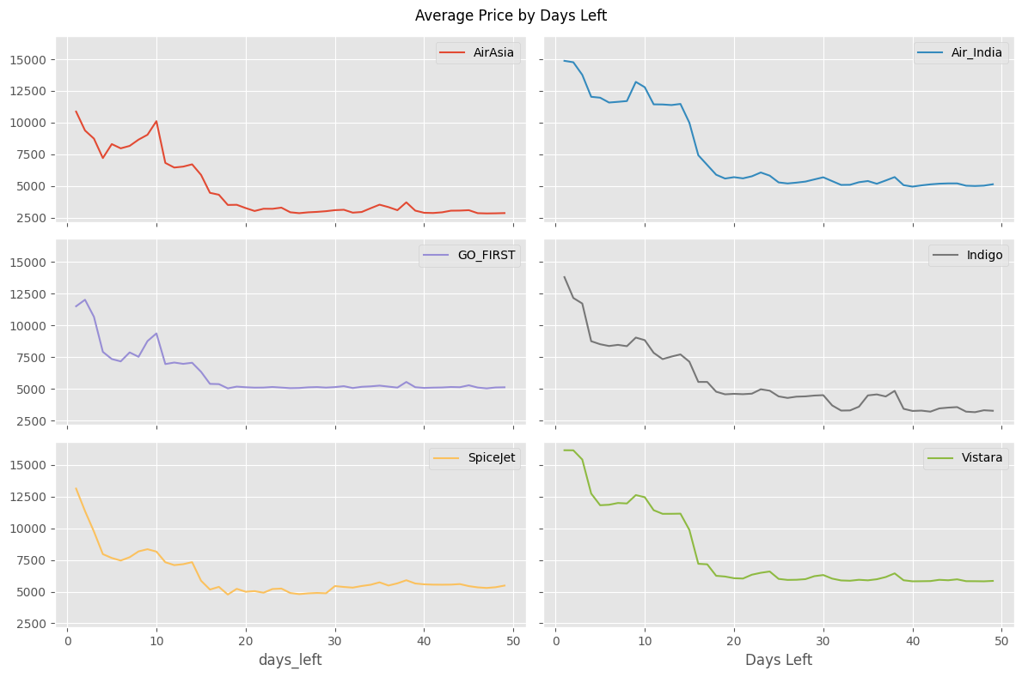
Economy Pricing vs Days Left

Slide 18
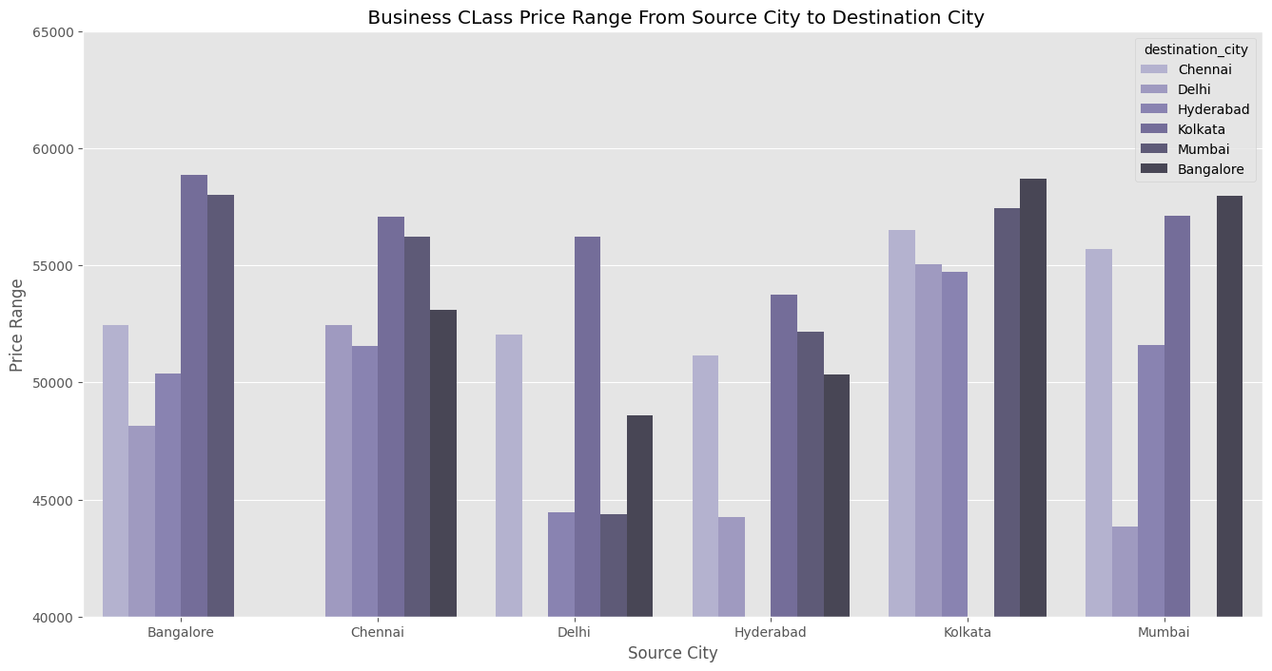
City to City Price variation(Business Class)

Slide 19
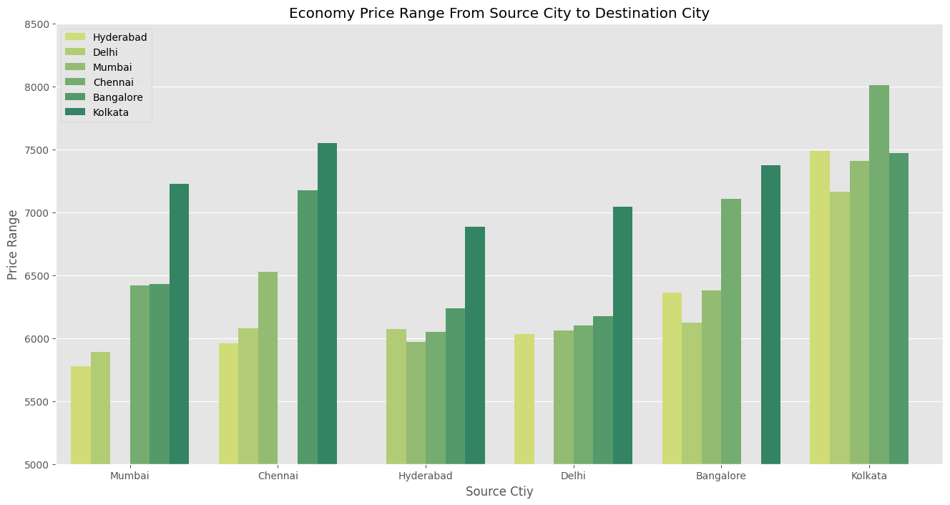
City to City Price Variation(Economy Class)

Slide 20
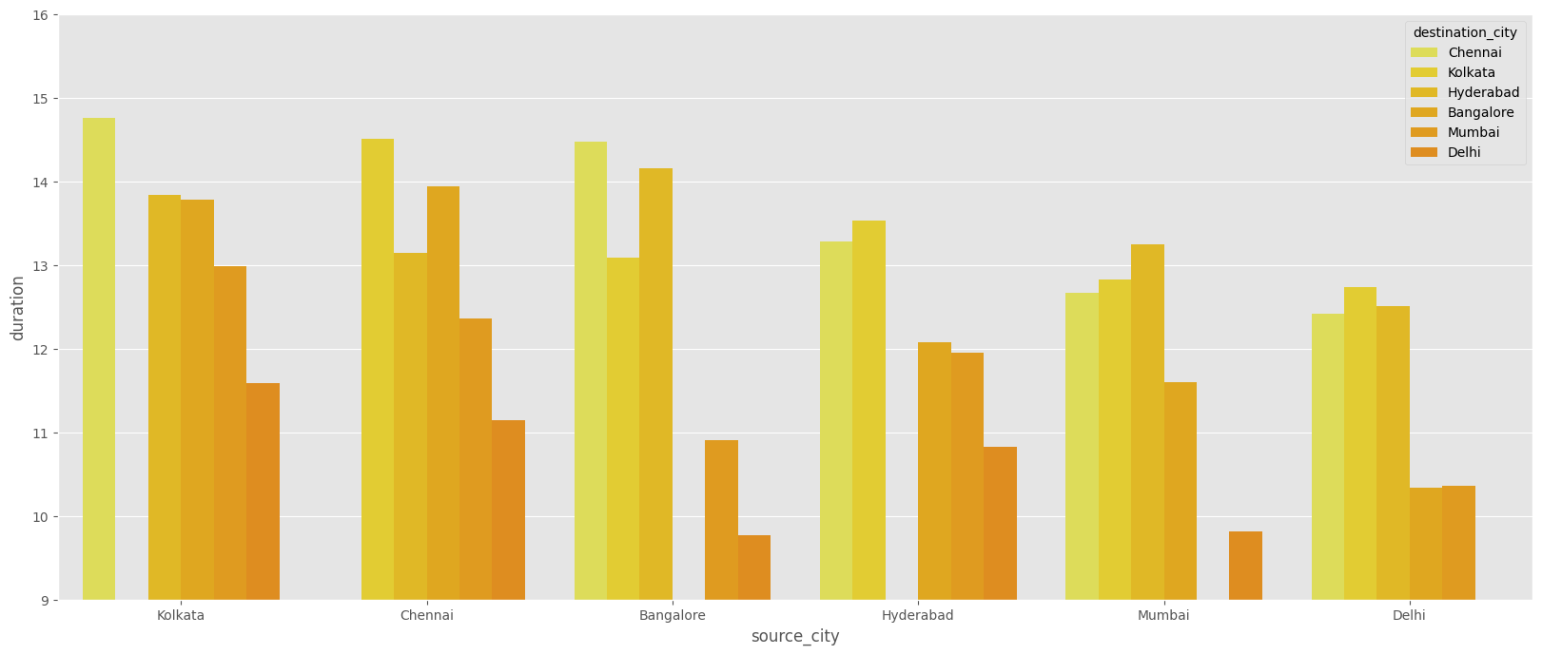
Average Duration From City

Slide 21
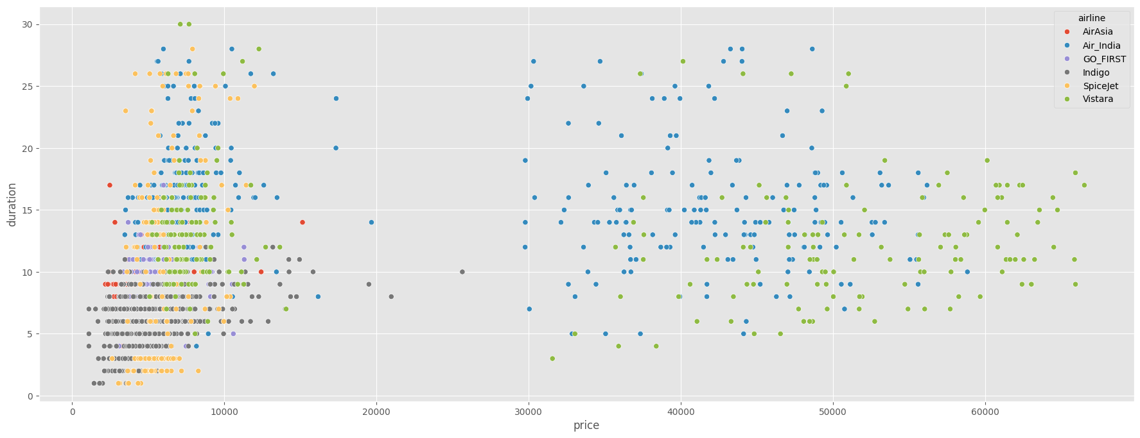
Price vs Duration

Slide 22
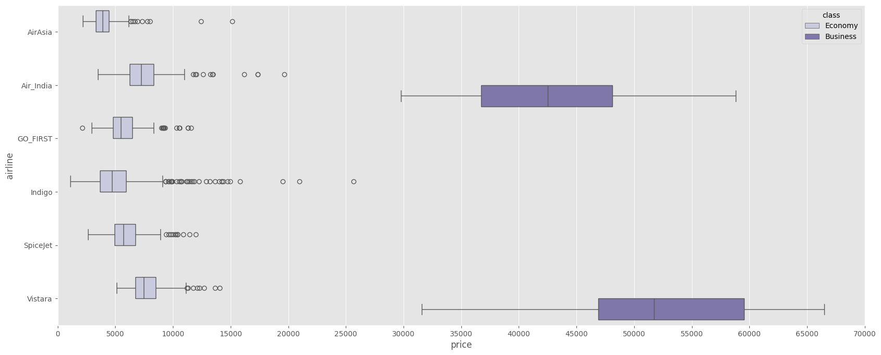
Price Airlines Offering

